Slide 1
Inventory Demand Forecasting
Faculty Coordinator – Shubha Meenakshi S
Team Members :-
Harsha K- 1BI20AI015
Hemanth Gowda N - 1BI20AI018

Slide 2

Abstract
The Inventory Demand Forecasting presented in this project harnesses the power of machine learning techniques to revolutionize the way businesses predict and manage product demand. By integrating advanced algorithms, historical sales data, and real-time information, the system enhances the accuracy of demand forecasting, allowing for optimal inventory levels and efficient supply chain operations. The IDMS employs a strategic approach, including data preprocessing, feature engineering, model selection, and continuous learning, to adapt to changing market conditions. The implementation of this machine learning-based system not only improves forecasting precision but also contributes to cost savings, customer satisfaction, and overall operational efficiency in the dynamic landscape of inventory management.

Slide 3
Introduction
Effective inventory management is integral to the success of businesses across diverse industries, and precise demand forecasting stands at the core of this strategic imperative. In a dynamic marketplace characterized by evolving consumer preferences, fluctuating market trends, and unforeseen external factors, the ability to accurately predict and respond to demand fluctuations is crucial. This project focuses on the development of an Inventory Demand Forecasting system, leveraging advanced machine learning techniques to harness the power of historical sales data, product attributes, and external variables. By employing cutting-edge algorithms, intuitive visualizations, and an adaptive learning approach, the goal is to empower businesses with a proactive and responsive inventory management strategy. This introduction sets the stage for a comprehensive exploration of the project's methodologies, objectives, and anticipated contributions to optimizing supply chain efficiency and driving overall business success. In today's dynamic business landscape, Inventory Demand Forecasting is essential for optimizing inventory levels and meeting customer expectations. This project utilizes advanced machine learning techniques to analyze historical data and product attributes, aiming to provide businesses with accurate demand predictions. By doing so, the project seeks to enhance operational efficiency, minimize holding costs, and ensure a competitive edge in responding to the fluid demands of the market.

Slide 4
Literature Survey
SL NO. | AUTHORS NAME AND YEAR OF PUBLICATION | Title name and Journals name | Abstracts or objects | Technique used | Limitation
1 | Hyndman, R. J., & Athanasopoulos, G. 2018 | "Forecasting: principles and practice" | The book provides a comprehensive overview of forecasting principles, covering statistical and time series methods. | CNN | may not delve deeply into specific machine learning techniques..
2 | Gallego, G., & Moon, I. 2020 | "Machine Learning for Operations Research: Advances and Potential Applications" | The paper discusses the advances and potential applications of machine learning in operations research, including techniques and challenges. | SVM | may not specifically focus on inventory demand forecasting.
3 | Ord, K., Fildes, R., & Kourentzes, N.2017 | "Principles of Business Forecasting" | This paper covers general principles of business forecasting, with an emphasis on statistical methods.. | Decision tree classification | may not extensively cover machine learning.
4 | Zhao, H., & Yang, Y. 2019 | "Sales demand forecasting in fashion retail industry with machine learning methods" | The paper explores machine learning methods for sales demand forecasting in the fashion retail industry. | ANN, Random forest | limitations in terms of the specific retail industry and machine learning methods.

Slide 5
Proposed System
1. Data Integration and Cleaning:
- Description: Raw data, including historical sales and product details, is centralized and cleaned to ensure consistency and quality.
2. Feature Engineering and Model Selection:
- Description: Relevant features like seasonality are engineered. The system employs machine learning models, including time series and advanced techniques, tailored to the forecasting task.
3. Real-Time Updates and Visualization:
- Description: The system adapts to real-time data, presenting forecasted demand trends through user-friendly dashboards and intuitive visualizations.
4. Continuous Learning and Monitoring:
- Description: A continuous learning mechanism retrains the model with new data, ensuring adaptability. Performance monitoring triggers alerts and incorporates feedback for continuous improvement.

Slide 6
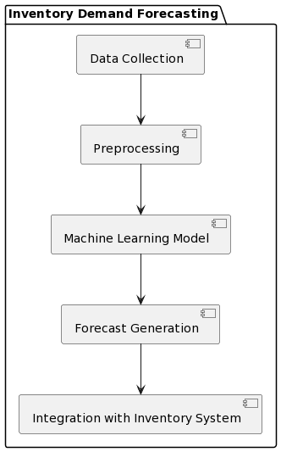
Block Diagram
1. Start Forecasting Process:
- The process initiation point indicating the beginning of the demand forecasting workflow.
2. Data Processing:
- Data Integration: Integration of raw data from various sources.
- Data Preprocessing: Cleaning and preparation of data for analysis.
- Feature Engineering: Identification and engineering of relevant features.
3. Machine Learning:
- Machine Learning Model Training: Training of machine learning models using the prepared data.
- Model Evaluation: Assessment of model performance through evaluation using rmse.
4. Visualization:
- Generate Dashboards: Creation of user-friendly dashboards for presenting forecasted results.
5. Continuous Learning:
- Continuous Learning Mechanism: Ongoing adaptation of the system through periodic retraining.
6. End Forecasting Process:
- The conclusion of the demand forecasting workflow.

Slide 7
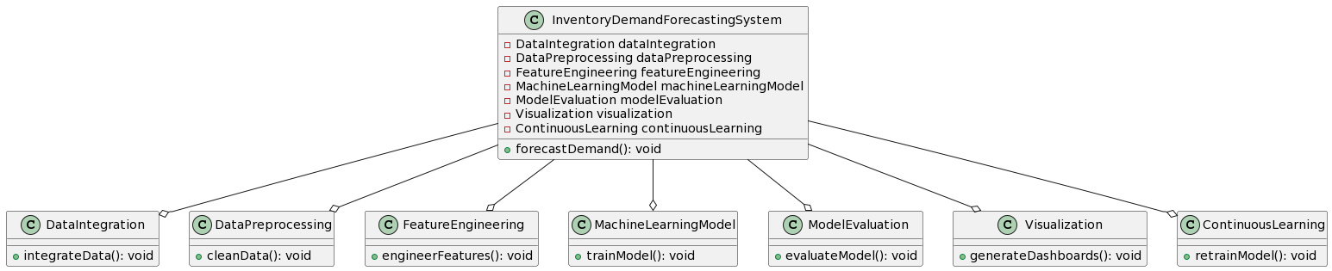
System Architecture
.
The UML class diagram illustrates the architecture of an Inventory Demand Forecasting system using machine learning techniques. Key components include classes for DataIntegration, DataPreprocessing, FeatureEngineering, MachineLearningModel, ModelEvaluation, Visualization, and ContinuousLearning. These classes collectively form the InventoryDemandForecastingSystem, emphasizing modularity and encapsulation. The relationships between the InventoryDemandForecastingSystem and its components denote their interdependence, highlighting the sequential flow of processes from data integration and preprocessing to model training, evaluation, visualization, and continuous learning for adaptive demand forecasting.
In this UML class diagram, the Inventory Demand Forecasting System is designed as a cohesive structure with specialized components addressing different aspects of the forecasting process. The DataIntegration and DataPreprocessing classes manage the ingestion and cleaning of raw data, while FeatureEngineering focuses on extracting meaningful features. The MachineLearningModel class encapsulates the training of forecasting models, and ModelEvaluation assesses their performance. Visualization generates user-friendly dashboards, and ContinuousLearning ensures the system's adaptability through periodic retraining. This diagram visually communicates the modular and interconnected nature of the system, emphasizing a systematic approach to inventory demand forecasting leveraging machine learning methodologies.

Slide 8
System Requirements
Hardware Requirements:
Software Requirements:
-CPU : Processor i5 or more
-RAM : 8GB
-Operating System
-Jupyter Notebook
-Anaconda Navig
-Python 3.8
Non Functional Requirements
Hardware Compatibility: The system's performance may be constrained by the hardware capabilities of the devices on which it is deployed. Older or less powerful hardware may experience slower processing speeds and could impact the real-time nature of face detection.
Data Availability and Quality: The project's success heavily relies on the availability and quality of labeled datasets for training and testing the machine learning models. Limited or poor-quality data may result in suboptimal model performance and generalization.
Computational Resources: Adequate computational resources are essential for training complex machine learning models, especially deep neural networks. Constraints in computational power may impact the scalability and efficiency of the developed system.
Time Constraints: Timely completion of the project is crucial, especially in the context of medical applications where prompt diagnosis is critical. Delays in model development and deployment may hinder the project's overall impact on healthcare.

Slide 9
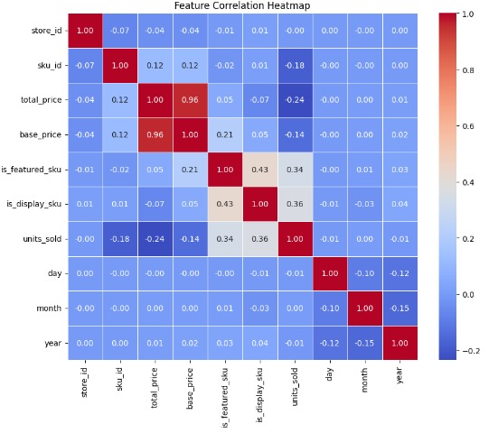
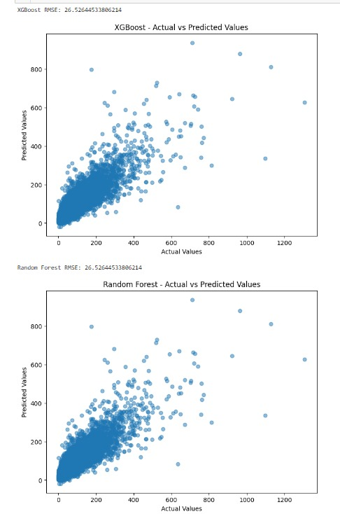
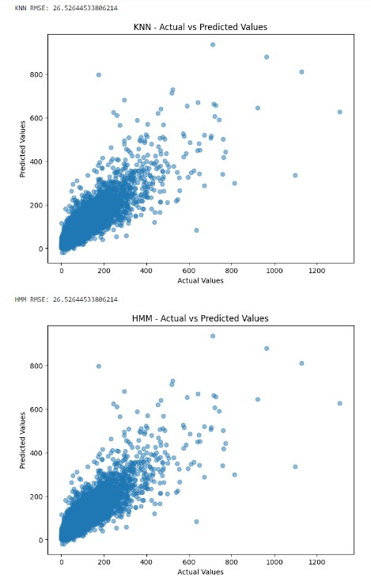
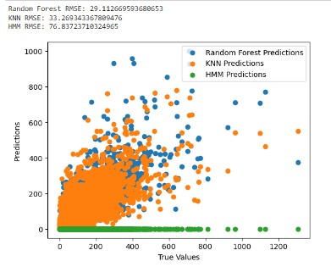
OUTPUT:

Slide 10
Thank You

